Slide 1
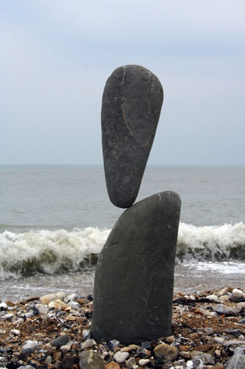
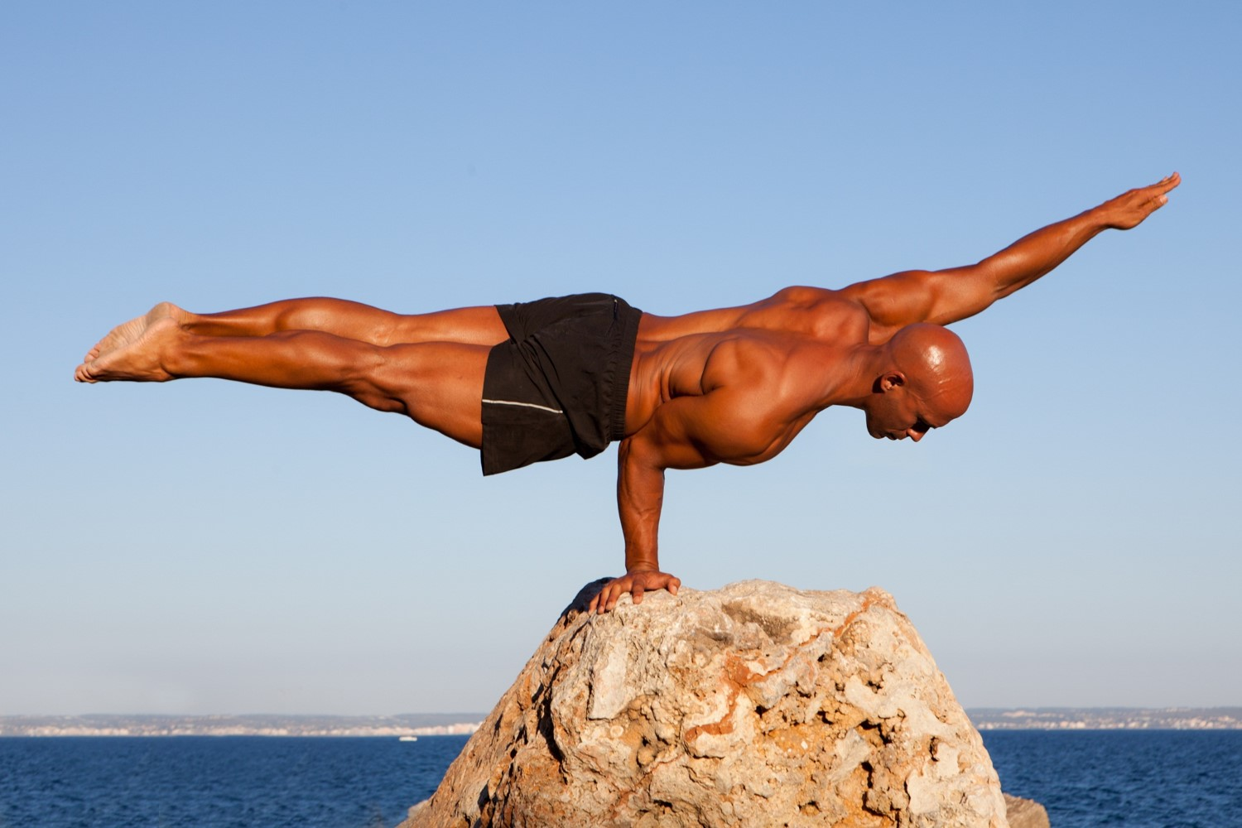
Moments – Rotational Equilibrium
Doing well in Physics is a “Balancing Act”.

Slide 2
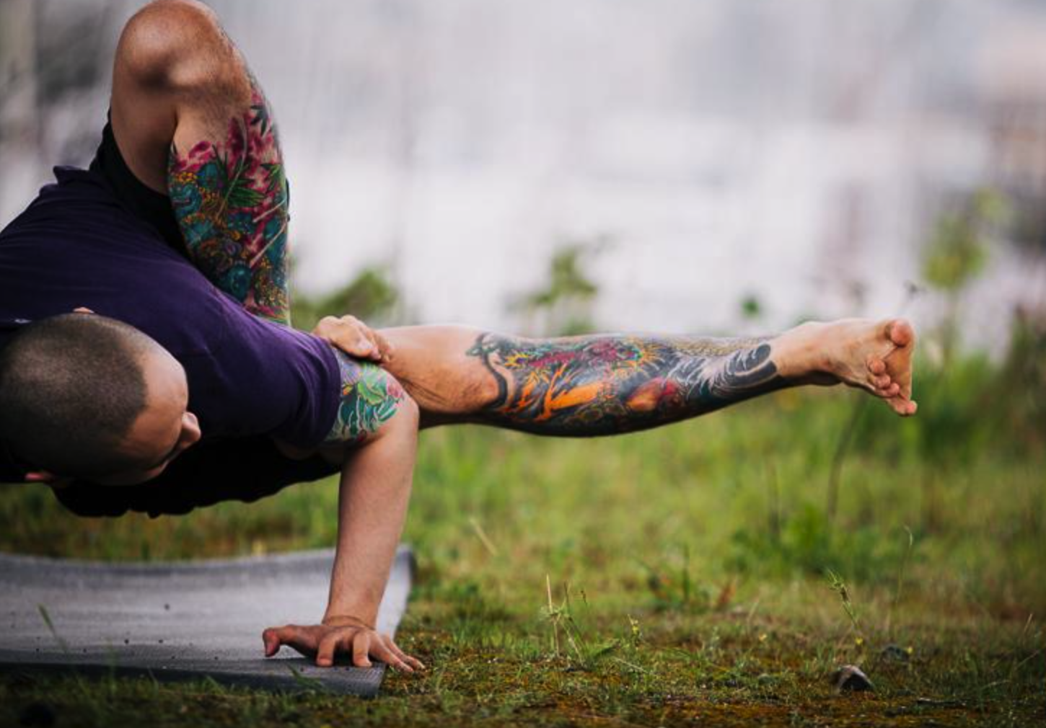
Today’s lesson
This looks harder than it actually is.
Know the principal of moments.
Apply to Rotational Equilibrium problems.
for a rigid body to be in equilibrium, the sum of the forces and the sum of the moments must be zero

Slide 3
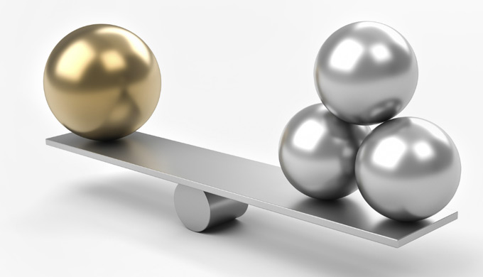
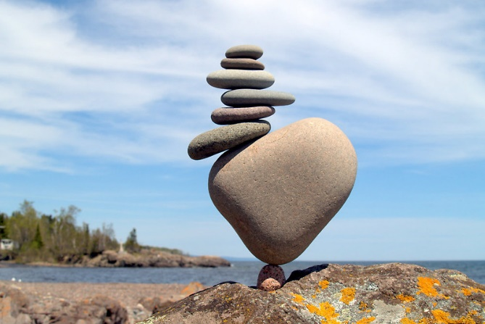
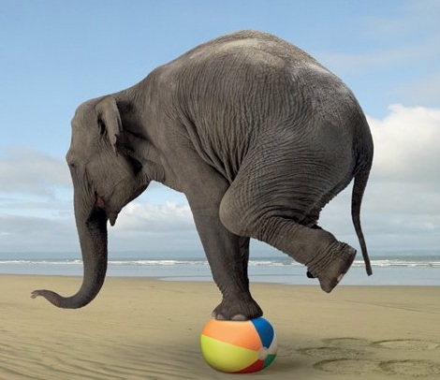
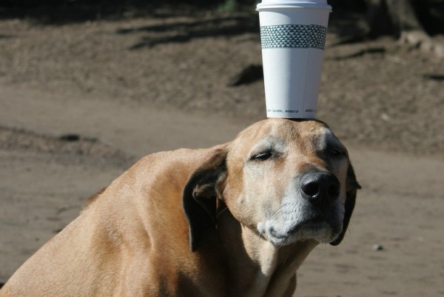
Equilibrium
For a rigid body to be in static equilibrium, the sum of the forces and the sum of the moments must be zero

Slide 4
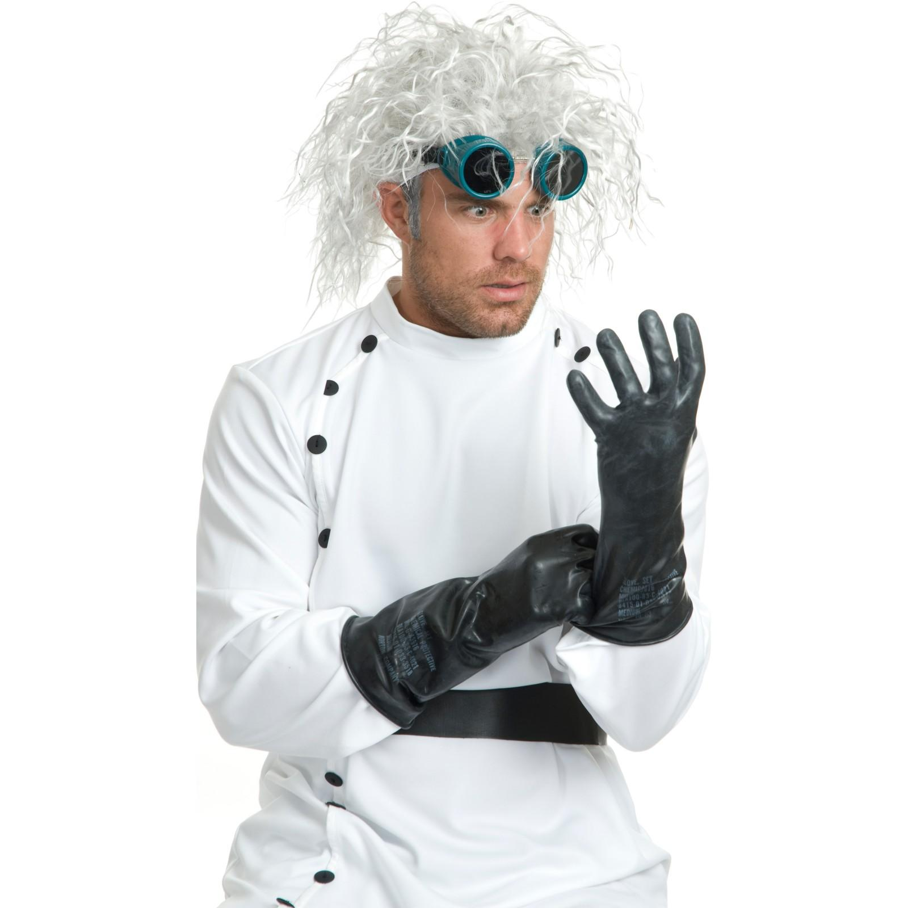
Principal of Moments
Rotational equilibrium is when the sum of the anticlockwise moments equal the sum of the clockwise moments.

Slide 5
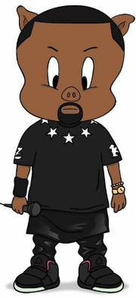
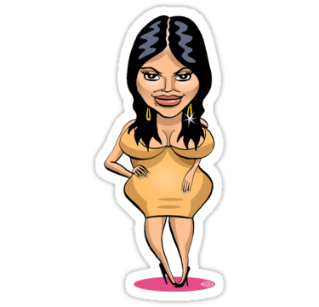
Equilibrium - More than one force
Take an uneven see-saw for an example
It’s not looking good Kanye!
Yo Kim!
Do you think we’ll be safe in this power point?
pivot

Slide 6
If the see-saw is balanced, what must be Kanye’s weight?
1.2 m
2.2 m
pivot
? N
637 N

Slide 7
The force on the left is trying to turn the see-saw anticlockwise about the pivot
1.2 m
2.2 m
pivot
? N
637 N

Slide 8
The force on the right is trying to turn the see-saw clockwise about the pivot
1.2 m
2.2 m
pivot
? N
637 N

Slide 9
If the see-saw balances, the turning effect anticlockwise must equal the turning effect clockwise
1.2 m
2.2 m
pivot
? N
637 N
Anticlockwise moment
=
clockwise moment

Slide 10
Anticlockwise moment = clockwise moment ∑ACM = ∑CM r F = r F 1.2 x Fw = 2.2 x 637 1.2 x Fw = 1401.4 ? = 1401/1.2 Fw = 1.17 x 10³ N
You fat little piggy!
1.2 m
2.2 m
pivot
? N
637 N
Anticlockwise moment
=
clockwise moment

Slide 11
Phew! We seemed to have survived the PowerPoint!
pivot

Slide 12
BOMB
Don’t speak too soon!
pivot

Slide 13
BOMB
. Yo, Kim, I'm really happy for you, I'ma let you finish, but…
pivot

Slide 14
BOMB
pivot

Slide 15
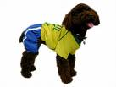
BOMB
pivot

Slide 16
pivot

Slide 17
Nice one!
pivot

Slide 18
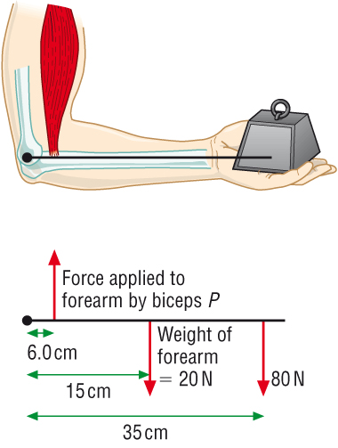




The Combined Turning Effect of Multiple Forces
What force does the bicep muscle need to apply to hold the mass?
$$ΣCM= ΣACM$$
$$F x r \left(Forearm\right)+F x r \left(mass\right)=F x r (bicep Muscle)$$
$$20 x 0.15 +80 x 0.35 =F x 0.060$$
$$3.0+28=F x 0.060$$
$$31=F x 0.060$$
$$F=517 N$$

Slide 19

The Combined Turning Effect of Multiple Forces
What is the counterweight (W) required to balance the light crane arm shown in diagram ?
$$ΣCM= ΣACM$$
$$rFsinθ\left(mass\right)=rFsinθ (counterweight)$$
$$5 x 70 x 9.8\sin{30}=3 x Fsin30$$
$$1715=1.5 x F$$
$$F=1140 N$$
5 m
60º
3 m
70 kg
W

Slide 20

The Combined Turning Effect of Multiple Forces
What is the tension (T) in the cable shown in diagram?
T
$$ΣCM= ΣACM$$
$$rFsinθ\left(top cable\right)=rFsinθ (angled cable)$$
$$25 x T\sin{90}=20 x 70 sin25$$
$$25 T=591.7$$
$$T=23.7 N$$
25 m
20 m
70 N
65º

Slide 21

The Combined Turning Effect of Multiple Forces
What is the tension (T) in the cable shown in diagram?
$$ΣCM= ΣACM$$
$$rFsinθ\left(suspended mass\right)=rFsinθ (angled cable)$$
$$3 x 20=T x 1.5 sin70$$
$$60=1.4095 T$$
$$T=42.6 N$$
T
70º
1.5 m
3 m
20 N

Slide 22
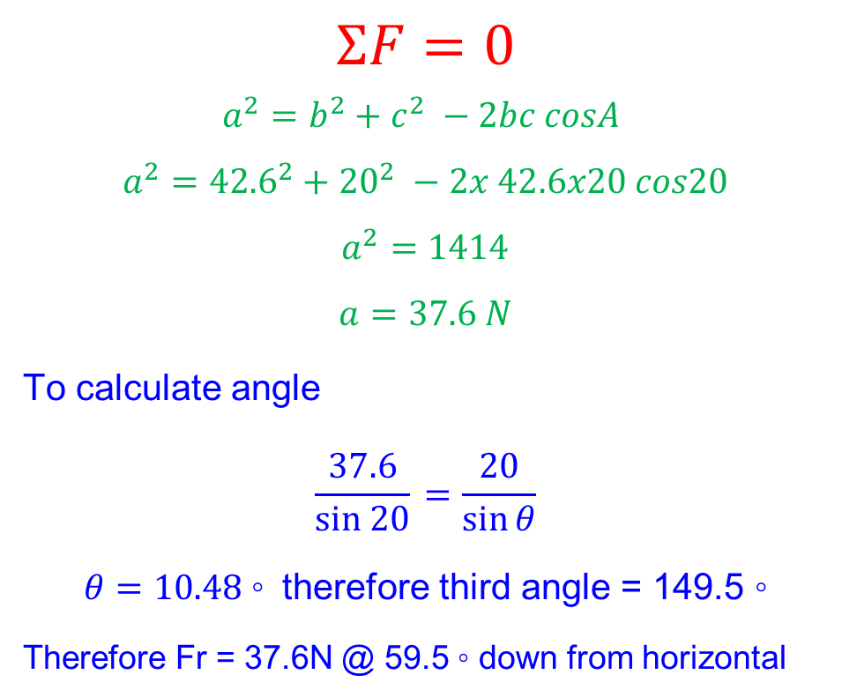
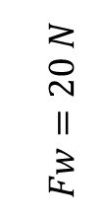

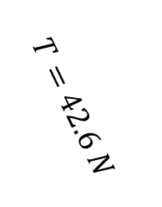
The Combined Turning Effect of Multiple Forces
There is a third force in this situation, provided by the reaction force from the wall at the pivot.
What is the size and direction of this force?
$$ΣF=0$$
$$a^{2}=b^{2}+c^{2} −2bc cosA$$
$$a^{2}={42.6}^{2}+{20}^{2} −2x 42.6x20 cos20$$
$$a^{2}=1414$$
$$a=37.6 N$$
To calculate angle
$$\frac{37.6}{sin 20}{ =\frac{20}{\sin{θ}}}$$
$θ=10.48◦$ therefore third angle = 149.5 $◦$
Therefore Fr = 37.6N @ 59.5 $◦$ down from horizontal
20º
$$Fw=20 N$$
T
$$T=42.6 N$$
70º
1.5 m
$$FR=?$$
θ
3 m
20 N

Slide 23
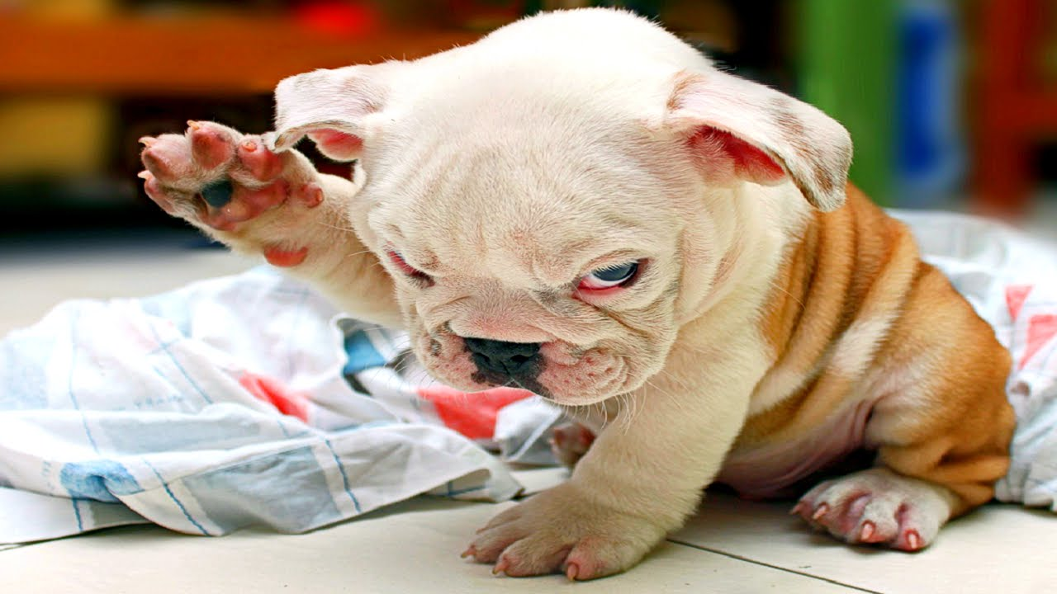
Any Questions?

Slide 24
You’ll have to do some problems now, or he’ll kill me too!
pivot

Slide 25
Static Equilibrium – Chapter 3.3
Hurry up … Open your books!
pivot

Slide 26
ATAR / WACE exam questions
2010 Q’s 2, 19
2011 Q’s 8, 10
2012 Q’s 5, 9 (v Difficult)
2013 Q’s 5.
2014 Q’s 13, 16
2015 Q’s 4, 15
2016 Q 18.
2017 Q 6, 9, 11 (hard),

